Slide 1
INNOVATHON ‘24
TEAM INNOV_X
Team Members :-
1.Biswajit Bhattacharya
2.Vivek Kumar
3.Anubhav Bhadani

Slide 2
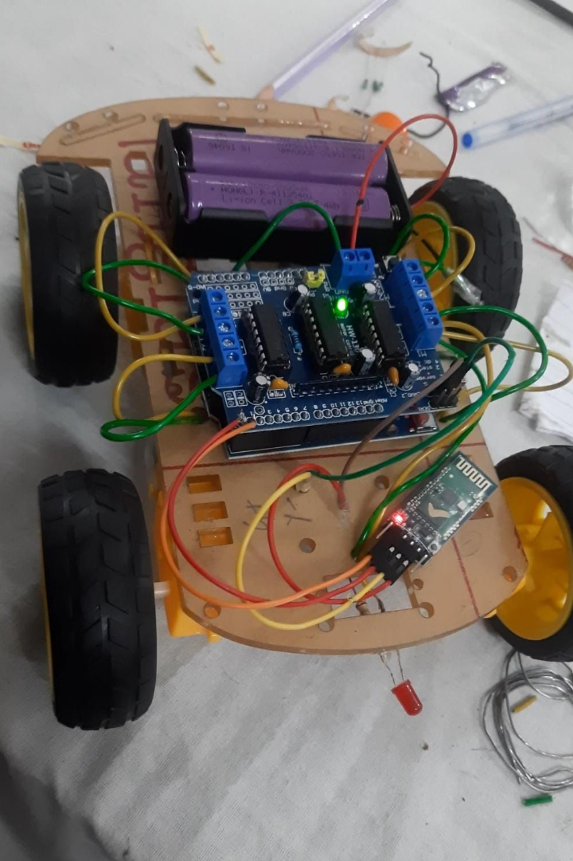

Bluetooth Controlled Navigable Rover
Our project focuses on designing a state-of-the-art rover capable of collecting soil samples. It will be controlled via Bluetooth technology, allowing for precise and remote operations.

Slide 3
Our Approach
Approach
1.We are developing a four-wheeled rover with four independent motor .
2.It's basic work will be to collect soil sample and displace it to some other place using relative velocity of front and back wheels .

Slide 4
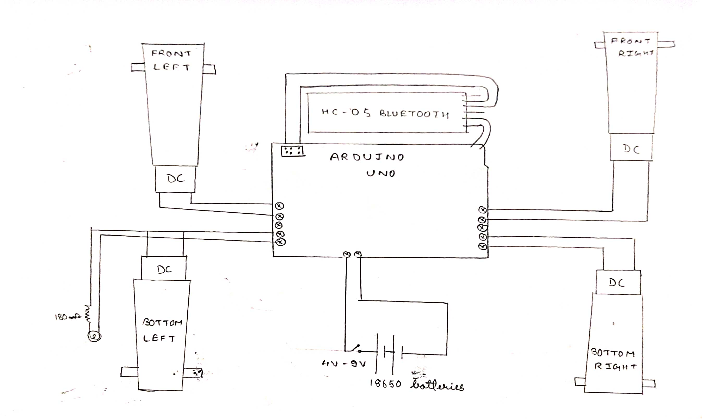

Slide 5
Mechanism
A sample-collecting rover typically uses a robotic arm equipped with specialized tools, such as drills or scoops, to gather samples from the surface. The process involves the rover positioning itself over the target area, deploying its arm, and then using the tools to extract or scoop up soil, rocks, or other materials. Once collected, the samples may be stored onboard for analysis or, in some cases, deposited into containers for return to Earth. The specific mechanisms can vary based on the design and mission objectives of the rover.

Slide 6
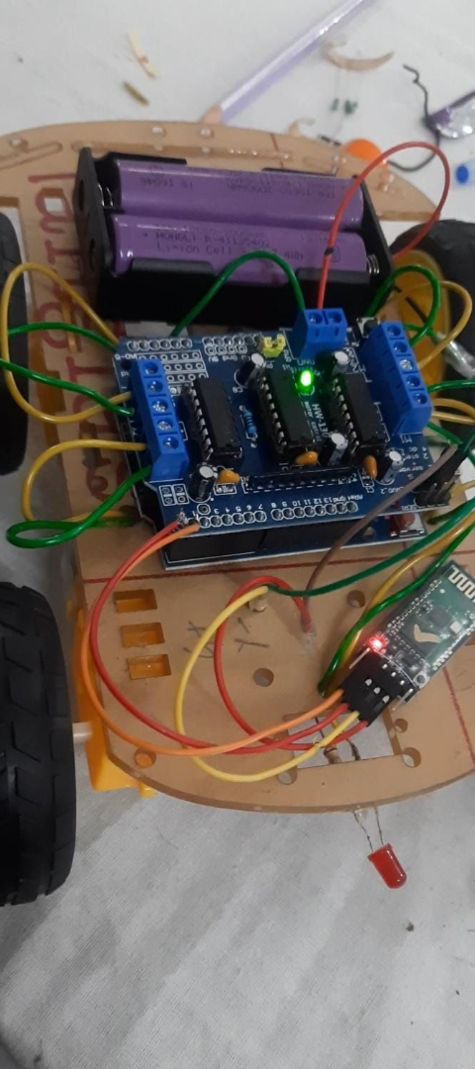
Soil Sample Collection Mechanism
1
Precision Sampling
2
Automated Analysis
The rover is equipped with a specialized mechanism designed to extract precise soil samples with minimal disturbance to the surrounding area.
Once collected, the soil samples are transferred to onboard analysis tools, providing real-time data for research and evaluation.
3
Efficient Retrieval
Efficient retrieval system for securely storing and protecting collected soil samples during the rover's mission.

Slide 7
Conclusion and Future Developments
Advancements in Autonomy: Continued progress in artificial intelligence and machine learning will empower rovers with greater autonomy, enabling them to make complex decisions and adapt to dynamic environments independently.
Miniaturization and Mobility: Advances in miniaturization will result in smaller, more agile rovers with improved mobility, enabling access to challenging terrains and the exploration of confined spaces.

Slide 8
USES
Engaging students and the public in STEM (science, technology, engineering, and mathematics) education by using sample collection rovers as educational tools. These rovers can simulate space exploration or environmental studies in a controlled and interactive setting.
Collecting samples from archaeological sites to study artifacts, bones, and other materials. Sample collection rovers can assist archaeologists in uncovering and preserving historical and cultural heritage.
Collecting samples from terrestrial environments to monitor and analyze air quality, soil conditions, water composition, and other environmental parameters. This can be useful for ecological studies, pollution monitoring, and habitat assessment.
Conducting geological surveys and analyzing rock and soil compositions. Sample collection rovers are used to study the geological history and mineralogy of various terrains, both on Earth and in space.

Slide 9
LIMITATIONS
It is applicable for soft soil only and works only in plain terrain
Works within the bluetooth range
Suitable environmental condition required.

Slide 10
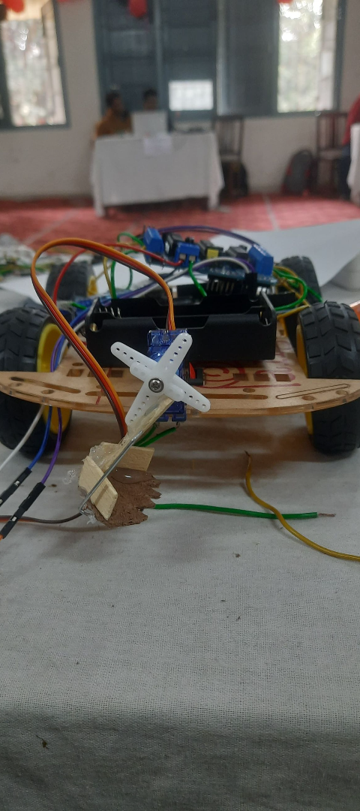
Final Remarks
Collaborative Partnerships
Sustainability Focus
Establishing collaborations with scientific organizations and research institutions to leverage expertise in rover technology and planetary exploration.
Emphasis on sustainable energy sources and eco-friendly materials for future rover designs, aligning with environmental conservation goals.
Community Engagement
Engaging with educational institutions and communities to inspire and educate about space exploration and scientific innovation.

